Slide 1
Postive Behaviour Supports
Teaching Replacement Behaviour for Obtain

Slide 2
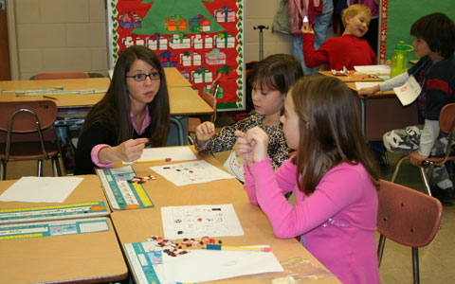
Replacement Behaviour
Appropriate behaviour that serves the same function as a problem behaviour
Need to teach and reinforce the new positive behaviour
If we don’t teach a new behaviour, the student will come up with a new way to get what s/he wants

Slide 3
Teaching Replacement Behaviours
The Basic Sequence
Identify situations where the new skills will be appropriate
Select the skill to teach
Determine the threshold point at which the student is likely to engage in the target behaviour
Prompt the replacement behaviour before s/he is likely to engage in the target behaviour
Reinforce the replacement behaviour - in the early stages of learning shape responses and reinforce approximations

Slide 4
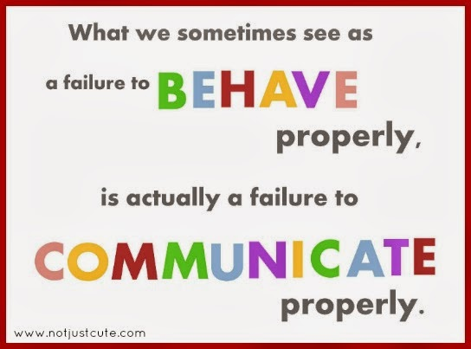
Teaching Replacement Skills

Slide 5
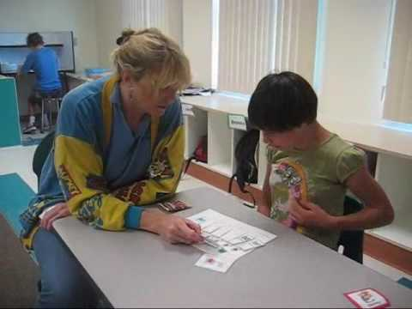
What to teach?

Slide 6
A simplified way of framing the assessment and intervention process
Antecedent | Behaviour | Consequence
Proactive | Teach | Response
You

Slide 7
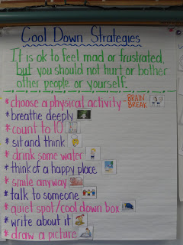
Class: Calm down

Slide 8
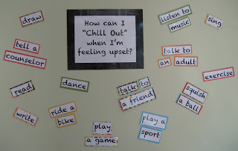
Class: managing emotions

Slide 9
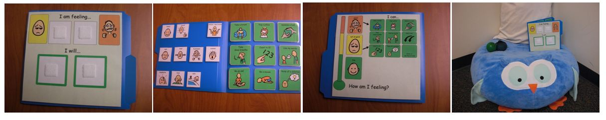
Visuals in the environment

Slide 10
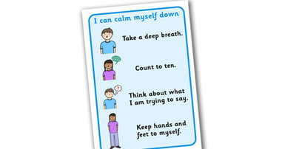
Personal script

Slide 11
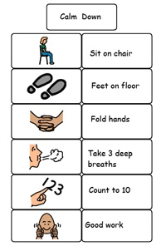
Personal procedural script

Slide 12
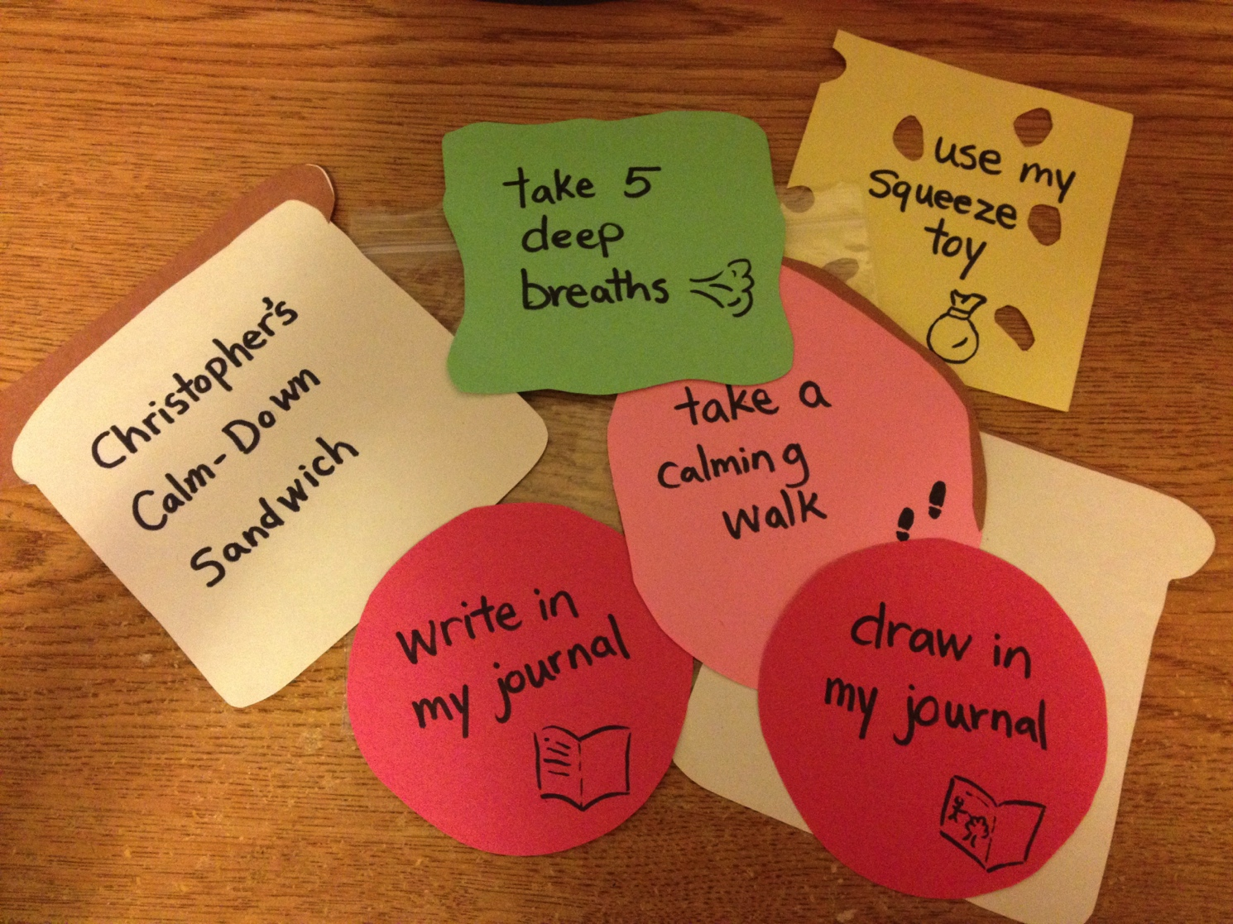
Pre-teaching tool

Slide 13
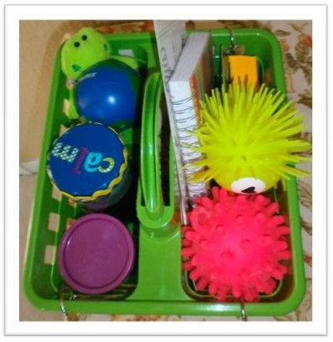
Calming caddy

Slide 14
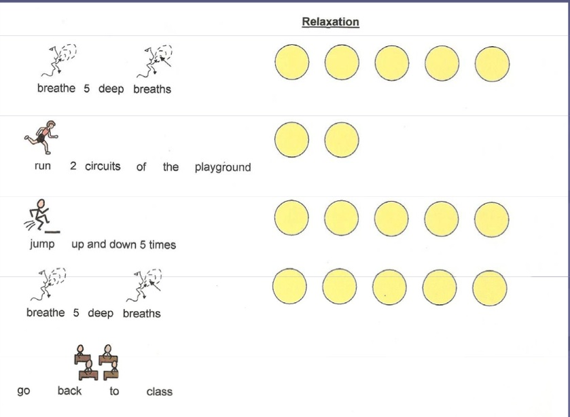
Relaxation

Slide 15
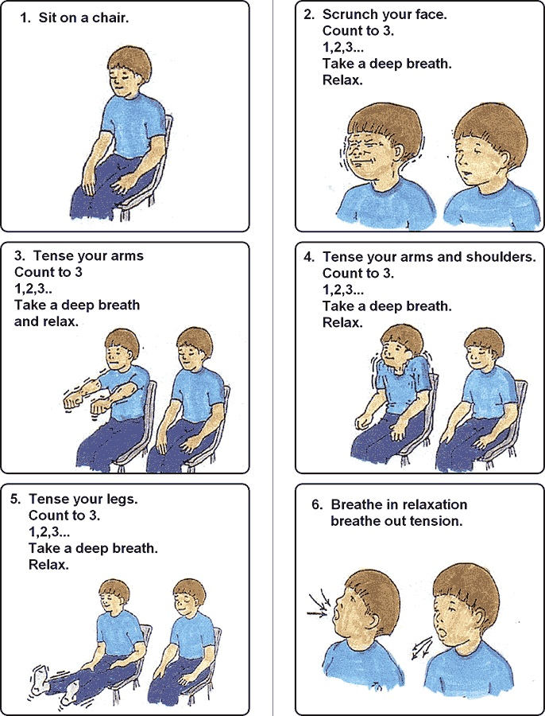
Relaxation training

Slide 16
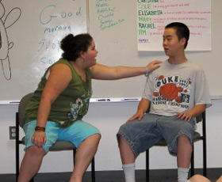
Social interaction

